Slide 1
CourierService
We Connect Emotions

Slide 2
ABSTRACT
This full stack app will be developed using the MEAN (MongoDB Express Angular Node.js) stack.
A JWT based authentication system is designed from scratch. Advanced CRUD (Create Read Update Delete) functionality will be implemented along with search operation.
Server/API and Client/Web app will be built separately. We will host four different types of users in our app. First is the Admin who will monitor everything and able to perform task on remaining three.
Second is Customer who will apply for a courier pickup from its place using our app.
Third is delivery person which is assign after courier placed from respective location.
Fourth is courier itself.
For the database we are using MongoDB.The user information (password etc) is encrypted using the bcrypt library of react

Slide 3
Technology used MEANstack
01
02
03
04
Mongodb
Express.js
Mongodb is a source-available cross-platform document-oriented database
A minimal and flexible Node.js web app Framework
Angular
Node.js
A platform for building mobile and desktop web application
Node.js is a JavaScript runtime built on Chrome V8 JS engine

Slide 4
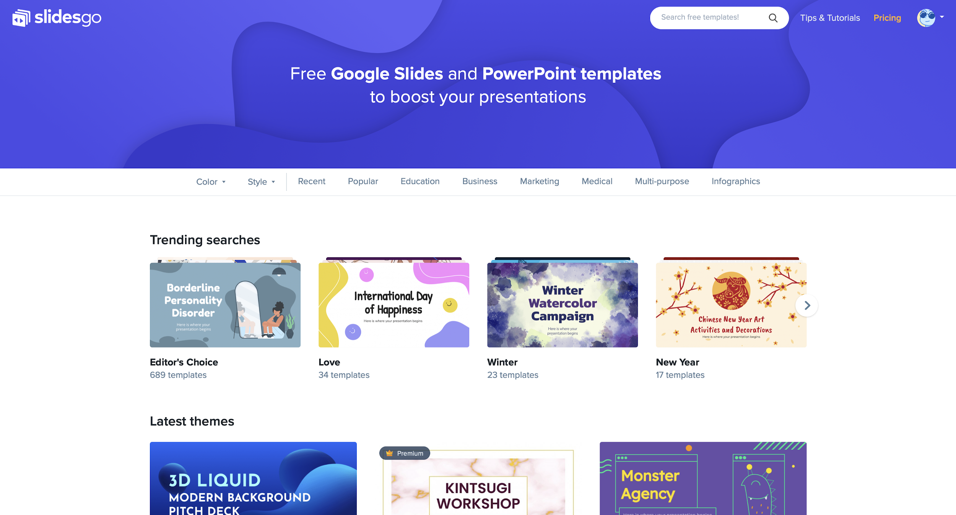
Courier Service
We Develop a MEAN stack web application. E-comm Business of courier Booking , in this a customer book his courier , courier type and package he wants to select , on the basics of form filled the deliver Person in allotted respective of location , then delivery Person updated the status of courier accordingly.
There is Admin Part also who having the record of deliverperon ,
We have authentication at every place according to type of section authentication is done by JWT and some functions.

Slide 5
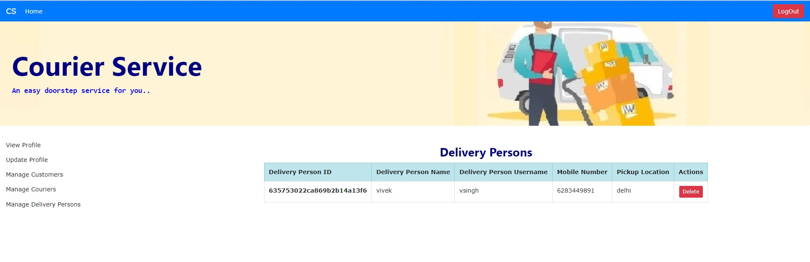

Slide 6
